Slide 1
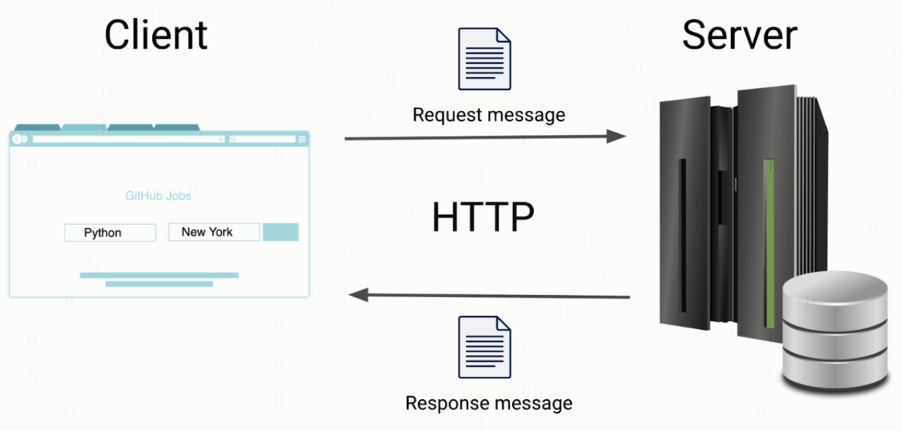
HTTP Message Structure

Slide 2
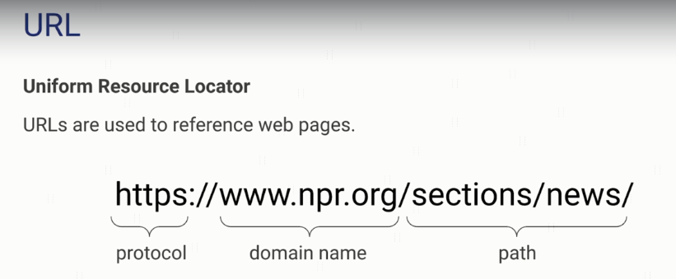
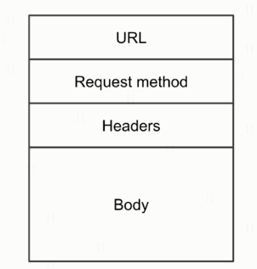
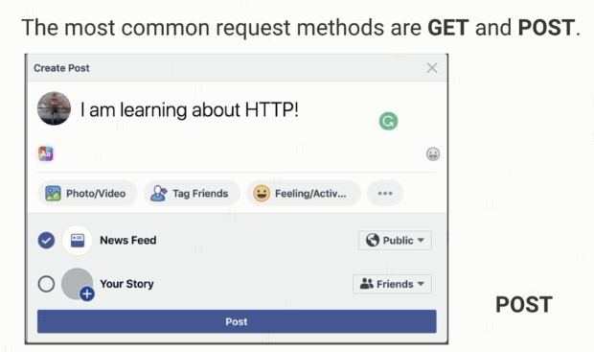
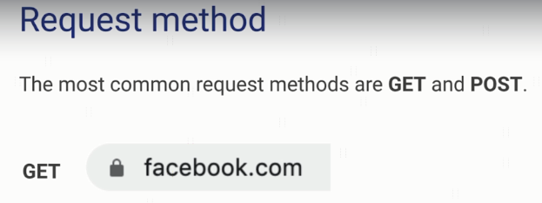
HTTP Message Structure
HTTP Request Message

Slide 3
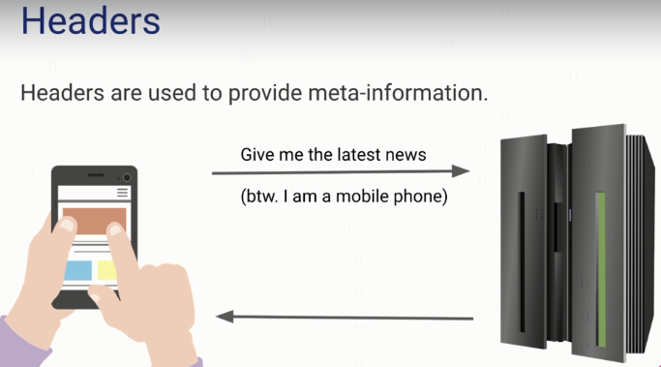
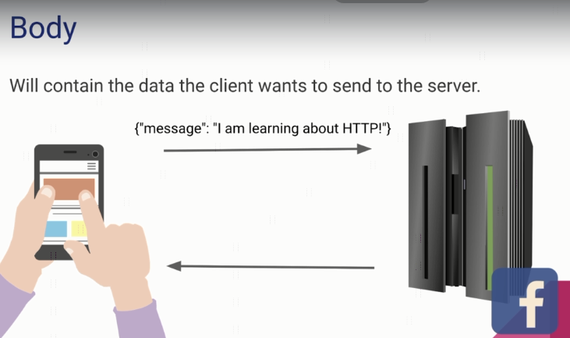
HTTP Message Structure
HTTP Request Message

Slide 4
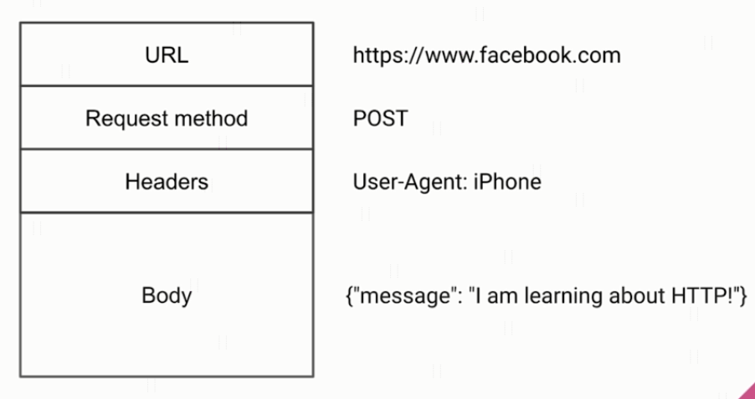
HTTP Message Structure
HTTP Request Message

Slide 5
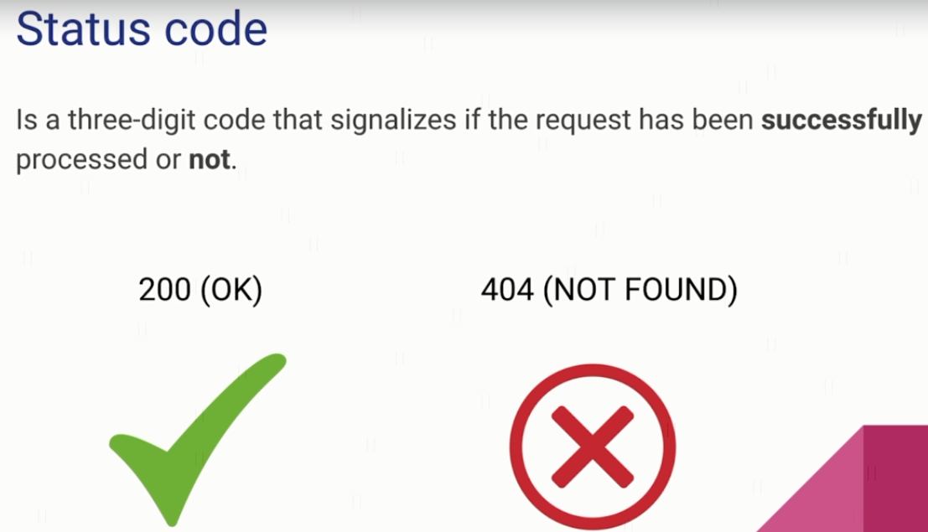
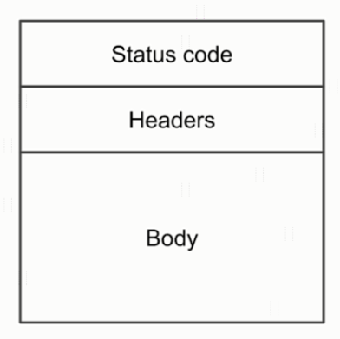
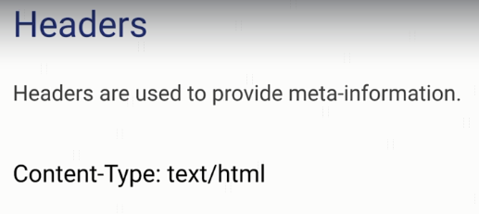
HTTP Message Structure
HTTP Response Message

Slide 6
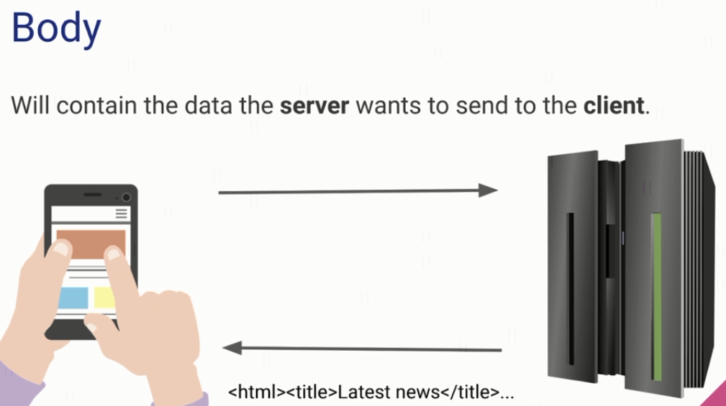
HTTP Message Structure
HTTP Response Message

Slide 7
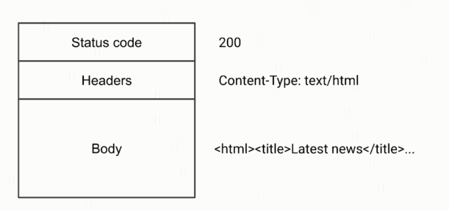
HTTP Message Structure
HTTP Response Message

Slide 8
HTTP Message Structure
https://www.udemy.com/course/introduction-to-apis-rest-api-graphql-soap-web-services-grpc/learn/lecture/18902264#overview

